Slide 1

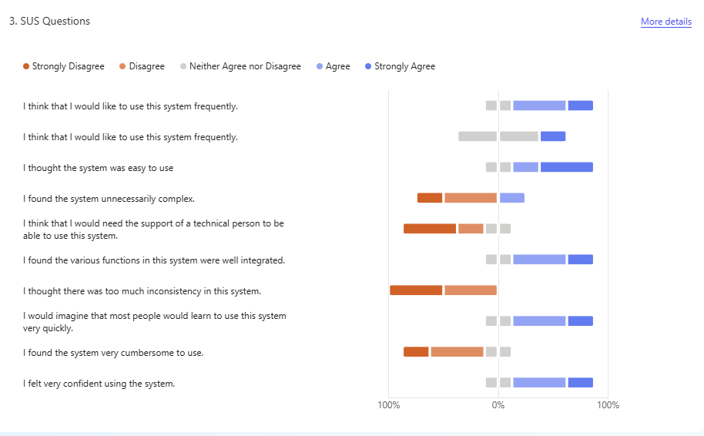
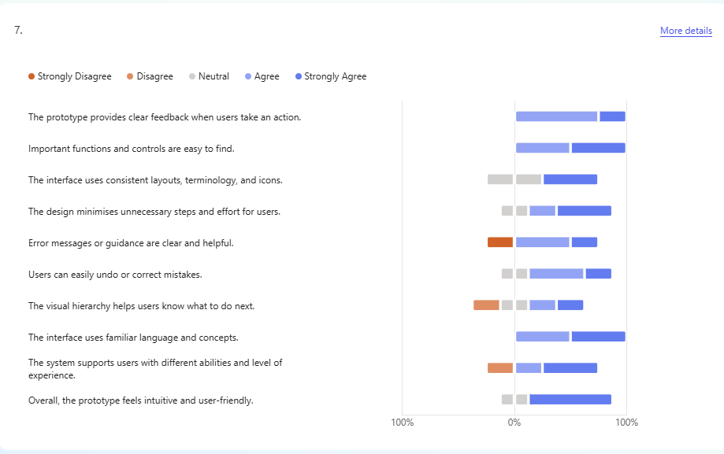
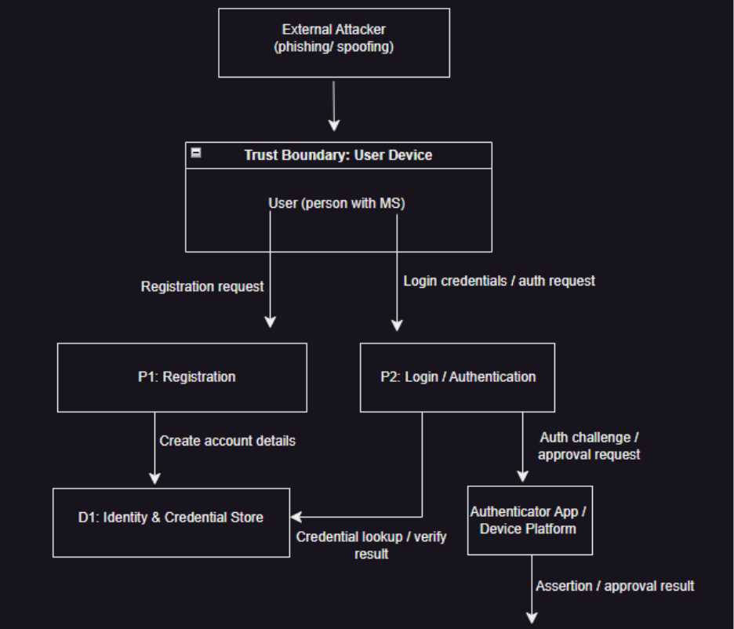
Inclusive Threat Modelling
Snow White
BSc (Hons) Ethical Hacking
Introduction
Method
Results
Discussion
Cybersecurity authentication systems are essential for protecting user accounts and personal data. However, many traditional approaches prioritise security over usability and accessibility, creating barriers for certain users.
Individuals living with Multiple Sclerosis (MS) may experience cognitive fatigue, memory difficulties, and motor impairments, which can make authentication processes challenging and error-prone. These barriers can unintentionally introduce security and privacy risks, such as increased susceptibility to phishing or account lockouts.
While approaches such as STRIDE and LINDDUN are widely used to identify system risks, they typically focus on technical vulnerabilities and overlook risks arising from user accessibility challenges.
This project explores how integrating accessibility into threat modelling can support the design of authentication systems that are both secure and inclusive.
Approach
Qualitative, design-oriented study
Focus: registration, login, recovery, session management
Threat Modelling
Data Flow Diagrams (DFDs) used to model system
Applied:
  STRIDE (security threats)
  LINDDUN (privacy threats)
Inclusive Adaptation
Extended models for accessibility (MS):
  Cognitive fatigue & memory issues
  Motor impairments
  Error-prone interactions
Treated as security & privacy risks
Design & Prototype
Developed inclusive security guidelines
Implemented authentication system:
  Passphrase + passkey login
  Accessible recovery options
  Minimal data collection
Evaluation
Expert-based testing (cybersecurity, accessibility, healthcare)
SUS + heuristic evaluation
Qualitative feedback collected
C
Figure 1. Extract from Level 1 Data Flow diagram (DFD)
Key Findings
Positive System Usability Scale (SUS) responses indicated strong perceived usability.
Figure 2. System Usability Scale (SUS) Results
Heuristic evaluation showed positive ratings for:
  interface clarity
  navigation
  feedback consistency
  accessibility considerations
Figure 3. Heuristic evaluation results
Qualitative Feedback Themes
Clear and intuitive layout
Accessible authentication and recovery options
Good balance between usability and security
Areas for Improvement
Registration clarity
Passkey onboarding
Reduced animation/motion effects
The findings suggest that accessibility-aware threat modelling can support the design of authentication systems that balance:
security
privacy
usability
accessibility
Adapting STRIDE and LINDDUN enabled identification of both conventional threats and accessibility-driven risks, including:
authentication failure and lockout
phishing susceptibility
insecure coping behaviours
This supports the argument that accessibility barriers should be considered potential security and privacy risk factors.
Conclusion
This project demonstrates that integrating accessibility into threat modelling can improve authentication and account recovery design without weakening security.
Accessibility barriers should be considered as part of secure system design rather than treated solely as usability issues.
Aim
To investigate how cybersecurity threat modelling can be adapted to support inclusive design for users with Multiple Sclerosis in authentication and account recovery systems.
OBJECTIVES
Analyse authentication and recovery processes using threat modelling
Adapt STRIDE and LINDDUN to include accessibility considerations
Identify security and privacy risks linked to usability barriers
Develop inclusive security design guidelines
Implement a prototype authentication system
Evaluate the approach through expert feedback.
References
Shostack, A. (2014) Threat Modeling: Designing for Security. Indianapolis: Wiley.
W3C (2023) Web Content Accessibility Guidelines (WCAG) 2.2. Available at: https://www.w3.org/TR/WCAG22/ (Accessed: 29/10/2025).
Adams, A. and Sasse, M.A. (1999) ‘Users are not the enemy’, Communications of the ACM, 42(12), pp. 40–46.

